Slide 1

Customer Shopping Behavior Analysis
Analyzing 3,900 customer purchases to uncover key insights into spending patterns, product preferences, and subscription behavior.

Slide 2

Project Scope and Dataset Summary
This project utilized transactional data to guide strategic business decisions across product, marketing, and loyalty programs.
Data Size
Key Features
3,900 Rows and 18 Columns of transactional data.
Includes demographics, purchase details (Category, Amount, Size), and shopping behavior (Discount, Frequency, Review Rating).
Missing Data
37 missing values in the Review Rating column were imputed.

Slide 3

Exploratory Data Analysis (EDA) in Python
The initial phase focused on data preparation, cleaning, and feature engineering using Python.
Data Loading & Exploration
Data Cleaning
Imported dataset and checked structure/summary statistics (df.info(), .describe()).
Handled 37 null values in Review Rating by imputing with the median rating per product category.
Feature Engineering
Database Integration
Created age_group (binned ages) and purchase_frequency_days columns.
Loaded the cleaned DataFrame into PostgreSQL for structured SQL analysis.

Slide 4
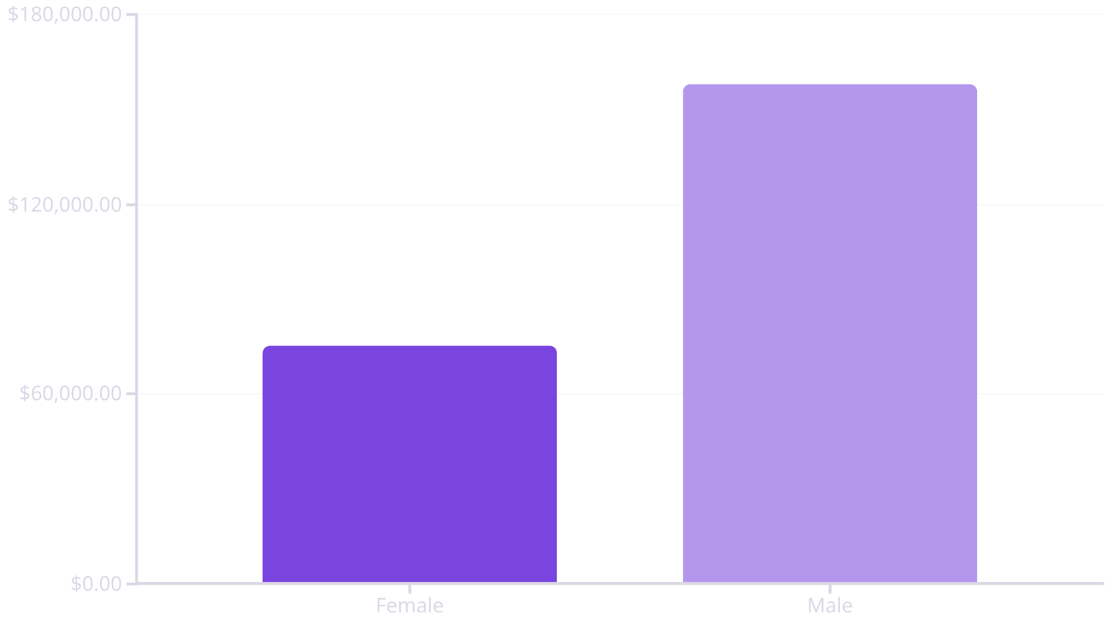

Key Financial Insights: Revenue & Spending
SQL analysis revealed significant differences in revenue contribution and spending habits.
Revenue by Gender
Subscription Impact
Non-subscribers generate significantly more total revenue, but average spend is similar.
Status
Total Revenue
Avg. Spend
No
$170,436
$59.87
Yes
$62,645
$59.49
Express shipping users have a higher average purchase amount ($60.48) compared to Standard shipping ($58.46).

Slide 5

Customer Segmentation and Loyalty
Customers were classified based on purchase history to understand loyalty distribution.
Loyal
Returning
3,116 Customers
701 Customers
New
83 Customers
Customers with >5 previous purchases are more likely to subscribe: 958 repeat buyers are subscribers vs. 2,518 who are not.

Slide 6
Product Performance: Top Rated & Discount Dependency
Top 5 Products by Average Rating
Discount-Dependent Products
1
Gloves
These products have the highest percentage of discounted purchases, indicating price sensitivity.
Average Rating: 3.86
Item
Discount Rate
2
Sandals
Hat
50.00%
Average Rating: 3.84
Sneakers
49.66%
3
Boots
Coat
49.07%
Average Rating: 3.82
Sweater
48.17%
4
Hat
Pants
47.37%
Average Rating: 3.80
5
Skirt
Average Rating: 3.78

Slide 7
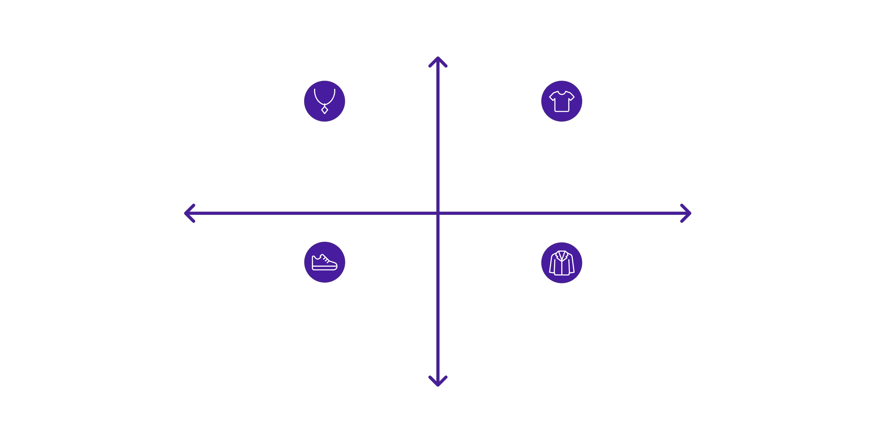
Top Products Across Categories
Identifying the most purchased items within the four main categories.
Highest Purchased
Accessories: Jewelry — 171 orders
Clothing: T‑Shirt — 320 orders
Category
Category
Footwear: Sneakers — 289 orders
Outerwear: Jacket — 214 orders
Lower Purchased
Example: In Accessories, Jewelry (171 orders), Sunglasses (161), and Belt (161) lead the sales.

Slide 8
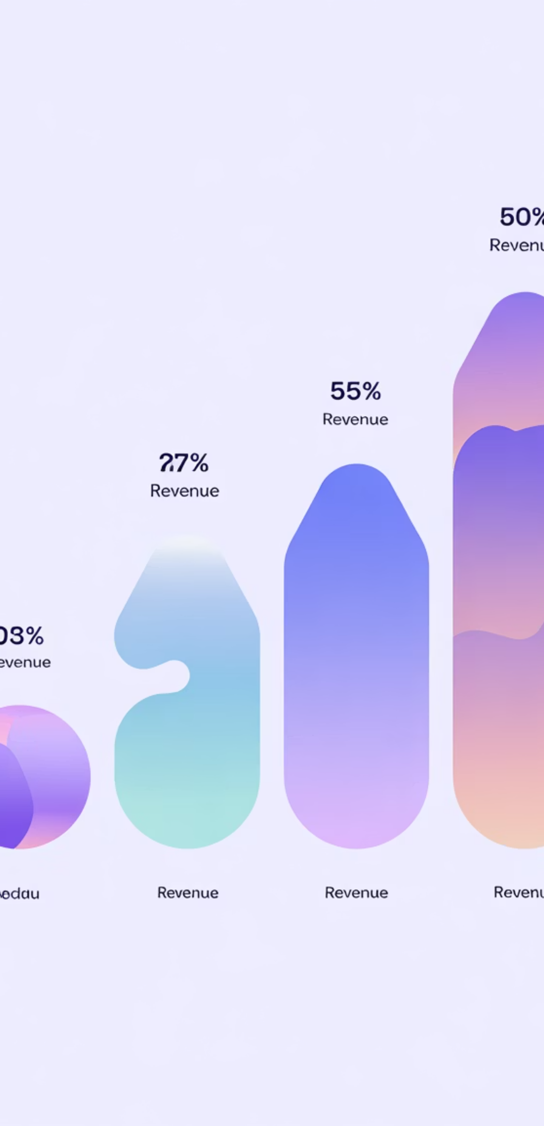

Revenue Contribution by Age Group
Understanding which age demographics drive the highest total revenue.
$62,143
Young Adult
Highest total revenue contribution.
$59,197
Middle-aged
Second highest revenue group.
$55,978
Adult
Solid revenue contribution.
$55,763
Senior
Lowest revenue group.

Slide 9
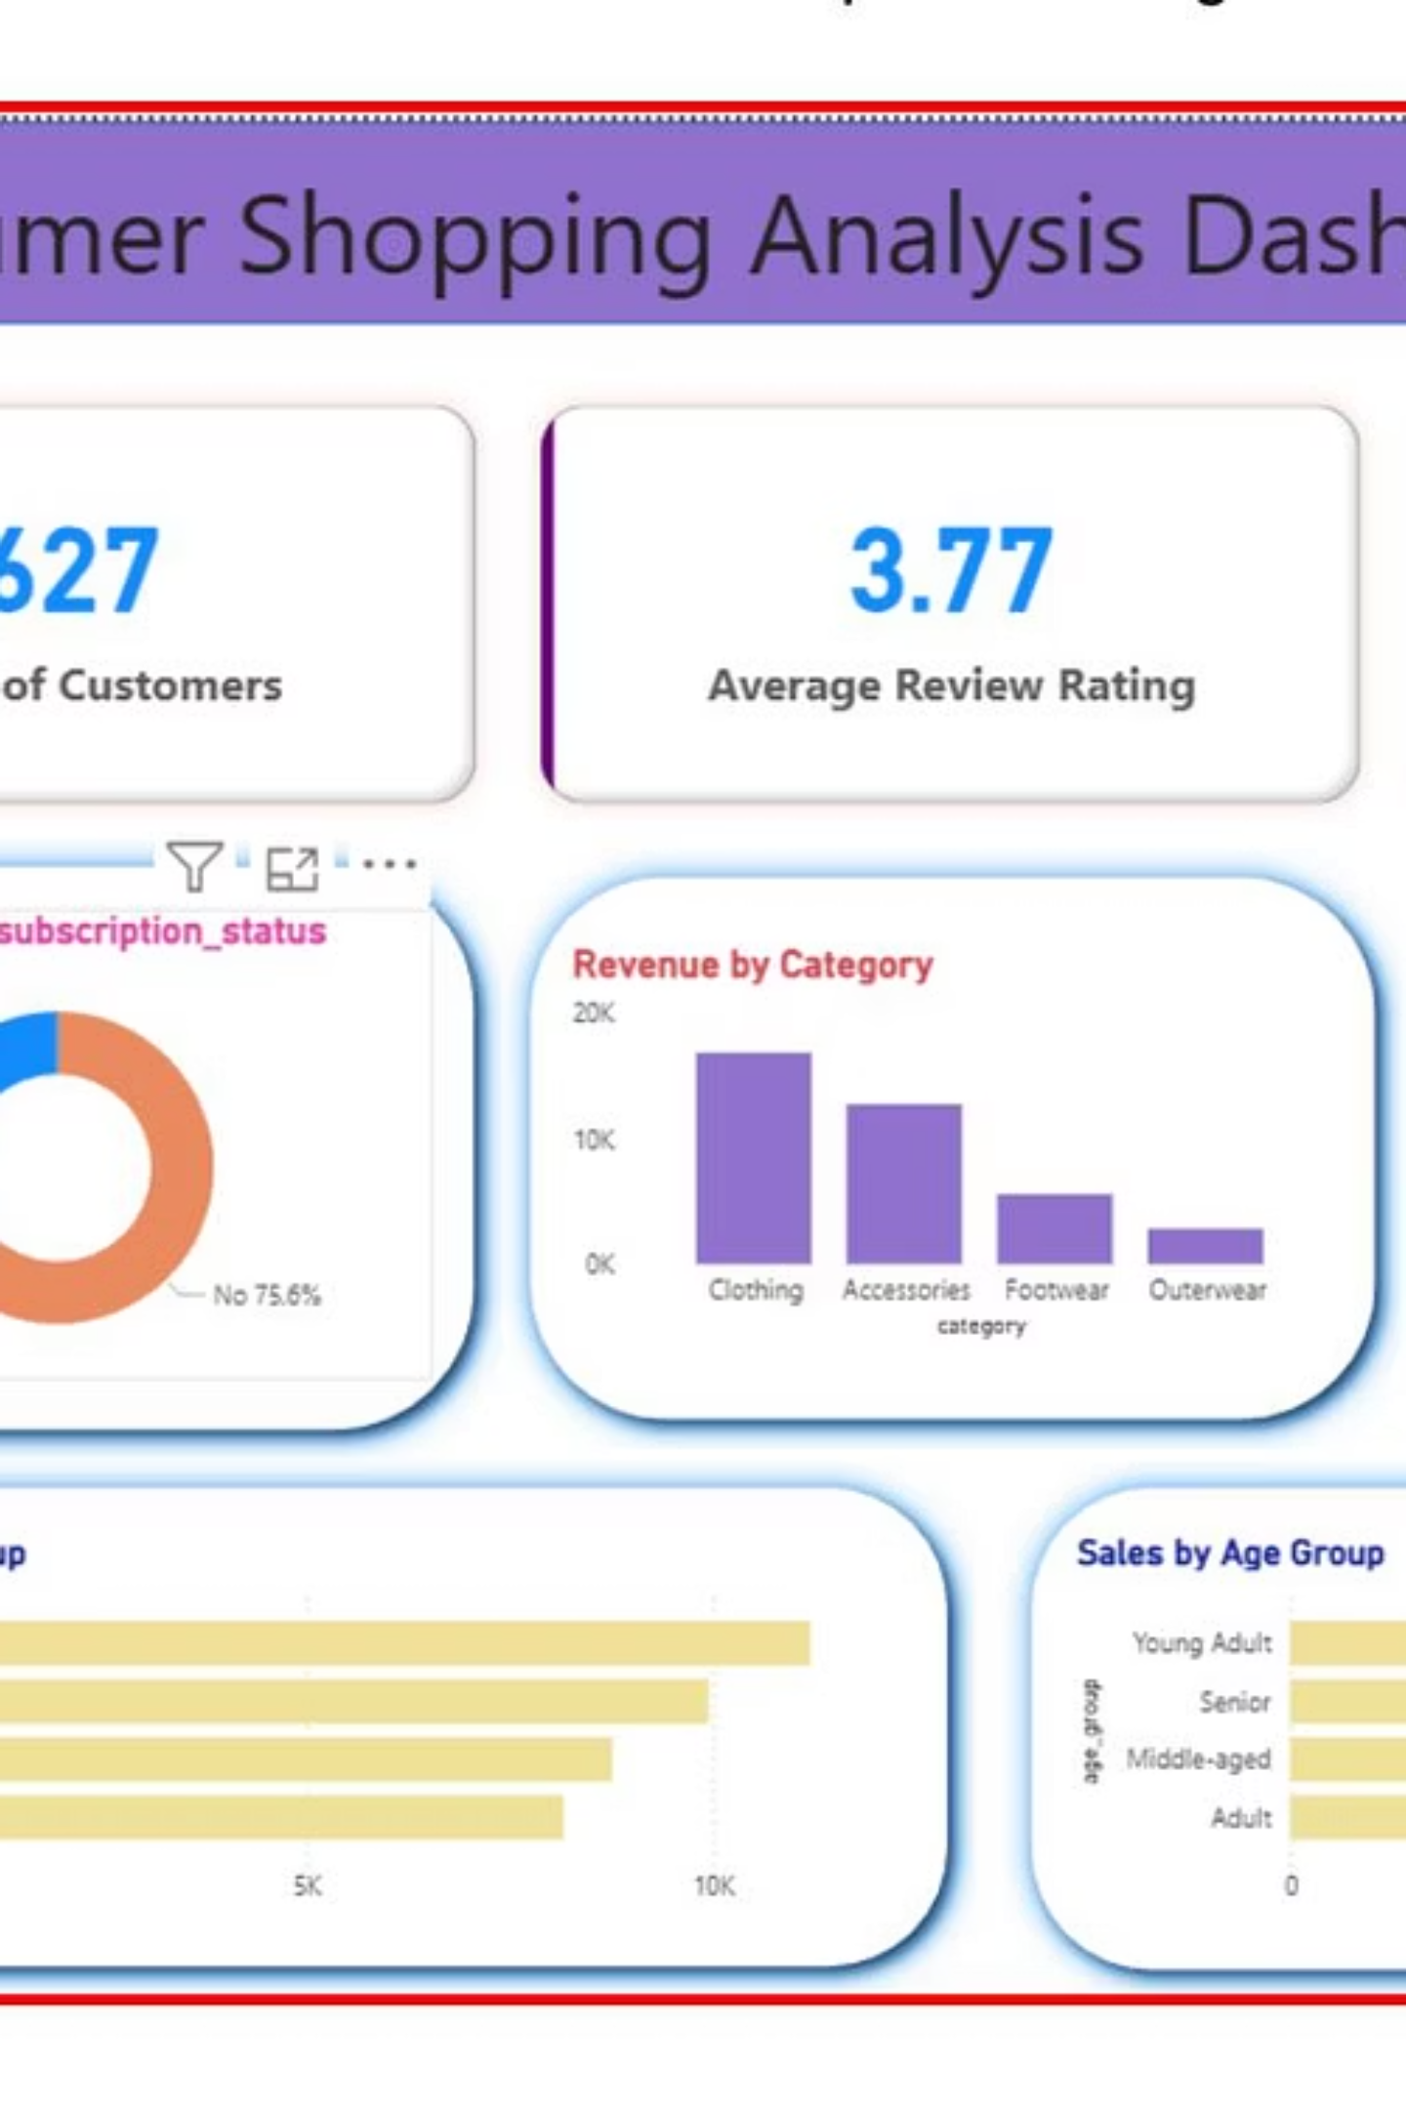

Visualizing the Data: Power BI Dashboard
All insights were consolidated into an interactive Power BI dashboard for visual exploration and presentation.
The dashboard allows stakeholders to dynamically filter and analyze data based on demographics, purchase details, and shipping types.

Slide 10

Strategic Business Recommendations
Boost Subscriptions
Customer Loyalty Programs
Promote exclusive benefits to increase the low subscription rate and total revenue from this segment.
Implement rewards to move Returning and New customers into the highly valuable "Loyal" segment.
Review Discount Policy
Targeted Marketing
Carefully balance sales boosts with margin control, especially for discount-dependent products like Hats and Sneakers.
Focus campaigns on high-revenue age groups (Young Adults) and Express Shipping users who show higher average spend.

